Slide 1

Hybrid Incident Response Agent
Under the Guidance of Dr G. Sudhakar
Presented by:
1. Bhavani Tanya Sri(2520030112)
2.Ch.Sai Geethika(2520090108)
3. P. Shashhe Preetham(2520030534)
AI-Powered Cybersecurity

Slide 2

01
Abstract
Table of Contents
02
Hardware Components
03
Software Components
04
Existing System
05
Proposed System Architecture
06
Conclusion

Slide 3

Abstract
The Hybrid Incident Response Agent (HIRA) is an AI-driven cybersecurity system designed to automate threat detection, analysis, and response. The system combines Search Algorithms, Constraint Satisfaction Problems (CSP), Bayesian Inference, Utility-Based Decision Making, and Explainable AI to provide intelligent and transparent security operations.
HIRA continuously monitors security events, identifies attack paths, evaluates risks, allocates resources efficiently, and assists human analysts in making informed decisions.

Slide 4

Hardware Components
Server Infrastructure
Hosts the HIRA application and security services.
Processes threat detection and response operations.
CPU/GPU Processing Units
Execute AI algorithms and cybersecurity analysis.
Support real-time threat monitoring.
Network Security Appliances
Firewalls, routers, and intrusion detection systems.
Monitor and filter network traffic.
Storage Systems
Store security logs, incident reports, and threat data.
Maintain historical records for forensic analysis.
User Workstations
Used by security analysts to monitor and manage incidents.
Provide access to the analyst workbench.
Network Infrastructure
Enables communication between servers, devices, and security components.
Supports data collection and threat intelligence sharing.

Slide 5

Software Components
Python Core programming language used for system development.
Search Algorithms (BFS, DFS, A)* Used for attack path tracing and threat investigation.
Help identify potential attack routes in a network.
Constraint Satisfaction Problem (CSP) Module Allocates incidents to analysts based on constraints.
Optimizes resource utilization and workload balancing.
Bayesian Inference Engine Performs probabilistic threat assessment.
Updates threat likelihood based on observed evidence.
Utility-Based Decision Module Evaluates response actions using expected utility.
Selects the most effective mitigation strategy.
Explainable AI (XAI) Framework Provides transparent explanations for AI decisions.
Improves trust and accountability.
Threat Detection Engine Detects suspicious activities and cyber attacks.
Generates alerts for potential threats.
Human Analyst Workbench Allows analysts to review incidents.
Supports manual approval, rejection, and override actions.
Incident Reporting Module Maintains incident logs and response history.
Generates security reports and audit records.

Slide 6

Existing System
Relies on manual monitoring and rule-based detection.
Requires human analysts for threat investigation and response.
Generates large numbers of security alerts.
Experiences delayed incident detection and mitigation.
Has high false positive rates and alert fatigue.
Lacks intelligent decision-making and automation.
Cannot efficiently handle multiple incidents simultaneously.
Provides limited scalability and adaptability to modern cyber threats.
Limitations
Slow response time.
Increased analyst workload.
Poor resource utilization.
Reduced threat detection accuracy.

Slide 7


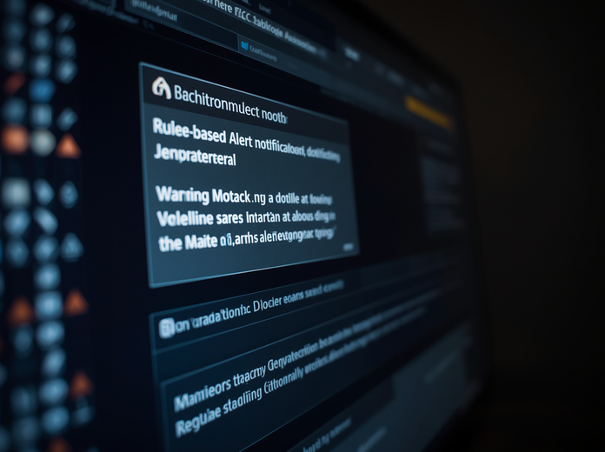

Existing Architecture
Manual Monitoring
Rule-Based Alerts
Human Analysis
Delayed Response

Slide 8

Proposed System
Develops an AI-powered Hybrid Incident Response Agent (HIRA).
Automates threat detection, analysis, and response processes.
Uses Search Algorithms (BFS, DFS, A*) for attack path investigation.
Implements CSP for efficient incident scheduling and resource allocation.
Applies Bayesian Inference for probabilistic threat assessment.
Uses Utility-Based Decision Making for optimal response selection.
Provides Explainable AI for transparent and understandable decisions.
Supports Human-in-the-Loop validation for critical incidents.
Improves response speed, accuracy, and overall cybersecurity management.
Advantages
Faster threat detection and mitigation.
Reduced analyst workload.
Improved decision accuracy.
Enhanced system reliability and security.

Slide 9
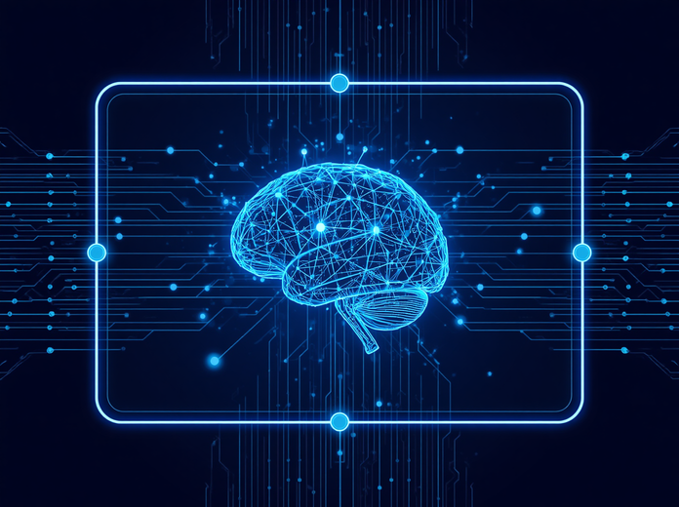


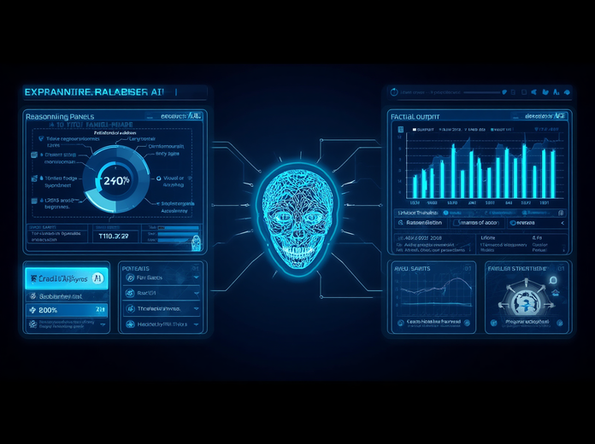
Proposed Architecture
AI Detection
Bayesian Engine
Decision Maker
Explainable AI

Slide 10

Thank You.
Questions & Discussion
We appreciate your time and attention throughout this presentation on the Hybrid Incident Response Agent.

